Slide 1
KNEE-CARTILAGE SEGMENTATION

Slide 2
PRESANTATION PLAN
INTRODUCTİON
MODELS
ARCHITECTURES
MATERIALS
PROGRAMMING STEPS IN DEEP LEARNING
RESULTS
DISCUSSION

Slide 3
INTRODCUTION

Slide 4
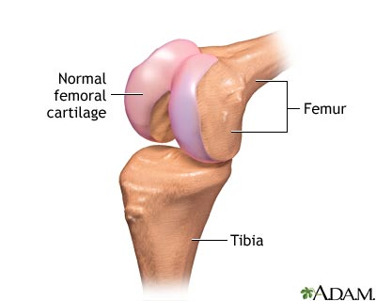
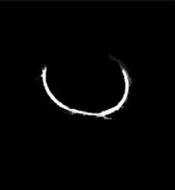
In my Project ;
First aim is segmenting knee femoral cartilage.It means that borders of this cartilage is extracted from knee and inside borders are painted. (This image is called mask.)
Second aim is to teach finding ( painted its borders ) where is knee femoral cartilage on knee MR images to my program.
Final aim is to find best result while calculating loss and accuracy values
Knee-Femoral Cartilage
Segmented cartilage image(Mask)

Slide 5
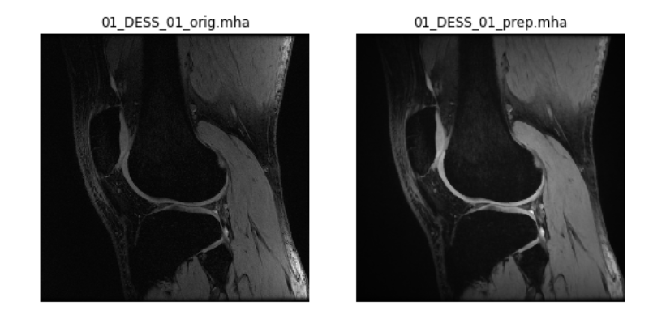
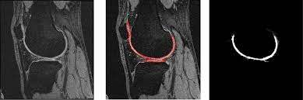
What I did in this Project is that basically;
I enhanced MR images to make easier learning by using preprocessing
I created segmented images (masks)
I converted all images to array numbers so that Computer can recognized what knee Mr images are.
I reduced and then increased size of arrays representing images with architectures to save time and cost. Additionally, I introduced images and mask of knee femoral cartilages to my program.
My program were teached where should be borders of cartilages While showing to mask of cartilges on train dataset.
My program calculated loss and accuracy after training.It compared trained dataset with validation dataset.
Then , Computer predicted where should be borders of cartilages on train dataset. Finally , I controlled whether predicted masks look like true mask or not.
01_DESS_01_orig.mha file is orginal MR image
, 01_DESS_01_prep.mha is preprocessed MR image.
First images is preprocessed MR image.
Second is MR image with segmented images.
Third is just segmented images which is named to Mask.

Slide 6
Scientifically;
What I did in this Project is called Image Segmentation.
Modern image segmentation techniques are powered by deep learning technology.I used Supervised Deep Learning.Because I prepared true orginial masks on Mr images .( I gave all inputs) And I hoped to obtain view of masks which looked like orginial masks at the finish. (there should be expected view of outputs exactly)
Two popular of deep learning architectures used for segmentation is that Convolutional Neural Networks (CNNs) and Residual Neural Networks(ResNet) in Image segmentation.And I used them in my project.
I utilized U-Net and Res U-net and their architectures which are a convolutional neural network that was developed for biomedical image segmentation.
My program language is Python.I work on Spyder.My framework is generally Keras which is supported from Tensorflow.
My dataset includes MR images which have Flair sequence. The main reason is that the femoral cartilage looks more prominent than the other sequences, so i can train my model more easily and successfully.

Slide 7
LET’S LOOK DEEPER

Slide 8
MODELS

Slide 9
Artificial Neural Networks(ANNs)
it is a simple mathematical model of the brain which is used to process nonlinear relationships between inputs and outputs in parallel like a human brain does every second.
Neural networks learn things in exactly the same way as the brain, typically by a feedback process called back-propagation .
Some architecture of ANNs includes:
Convolutional Neural Network
Residual Neural Network
Fully Convolutional Network

Slide 10
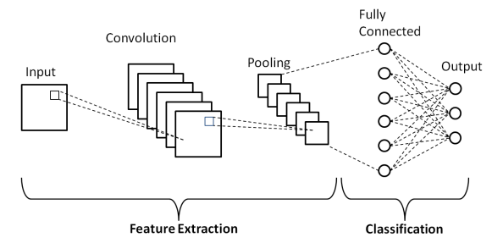
1-Convolutional Neural Network
CNN is deep learning algorithm.
CNN involves feeding segments of an image as input to a convolutional neural network, which labels the pixels.
The image becomes an array depending on the resolution and size of the image.Each entry in the array will consist of a number from 0 to 255
This number will represent the pixel intensity at that point.Taking all these numbers as input, the computer will output a number. This number will signify the probability of an image belonging to a certain class (for example house, road, bus, dog, cat, etc.)
It has popular 3 layer
The convolutional layer
The pooling layer
The fully connected layer

Slide 11
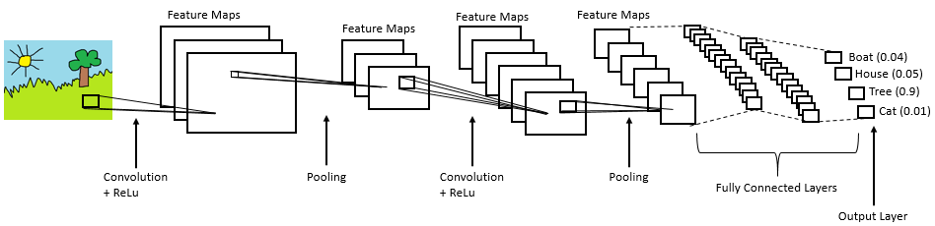
Convolution is the first layer to extract features from an input image.
Pooling layers section would reduce the number of parameters when the images are too large.
Fully Connected Layer is flattened matrix into vector and feed it into a fully connected layer like a neural network.
CNN architecture
(Rectified Linear Unit is a non-linear operation.ReLU’s purpose is to introduce non-linearity in our CNNs)

Slide 12
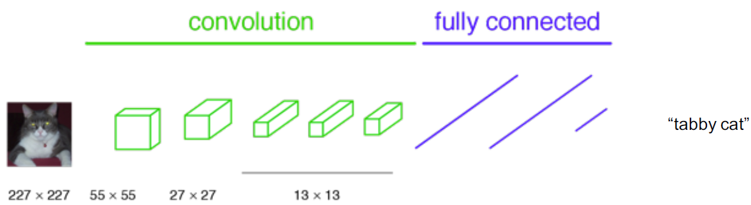
2-Fully Convolutional Network
FCN is similiar to CNN.But it is a network that does not contain any “Dense” layers (as in traditional CNNs) instead it contains 1x1 convolutions that perform the task of fully connected layers (Dense layers). It has no limitations on the input size at all because once the kernel and step sizes are described, the convolution at each layer can generate appropriate dimension outputs according to the corresponding inputs.
Convolution fully connected Layers

Slide 13
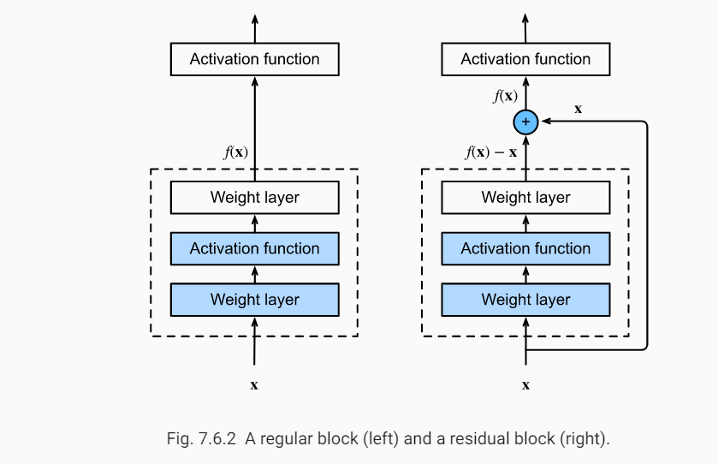
3-Residual Neural Network
ResNet is similiar to CNN. But, Residual neural networks do this by utilizing skip connections, or shortcuts to jump over some layers
The input to the output allows stops some layers from change the values of the gradient which means that we skip learning for some layers in ResNet.
The residual unit will ease the training of the network.Because , The skip connections within a residual unit and between low levels and high levels of the network will facilitate information propagation without degradation,
It make it possible to design a neural network with much fewer parameters.
A regular block (left) and a residual block (right)

Slide 14
Architecture

Slide 15
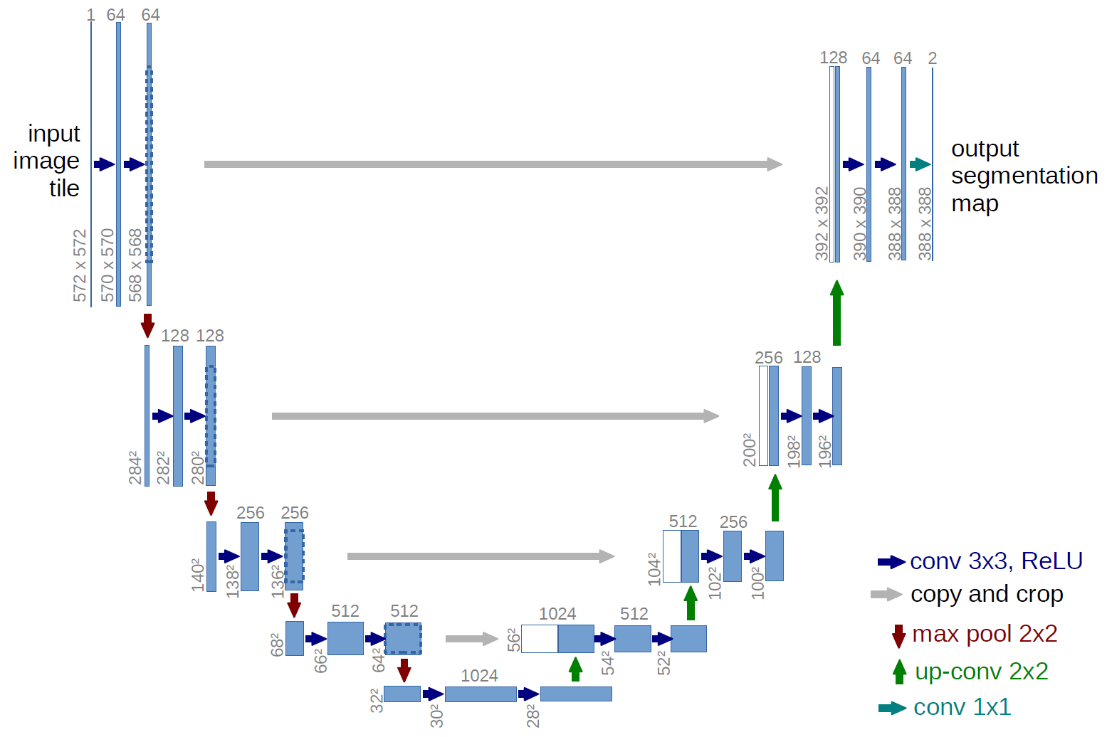
1-U-NET
The U-Net architecture is built upon the Fully Convolutional Network and modified in a way that it yields better segmentation in medical imaging.Its goal is to predict each pixel's class.
How U-net architecture works

Slide 16
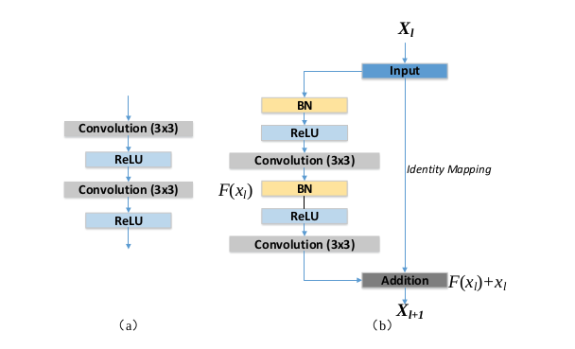
2-RESU-NET
ResUNet is a image segmentation model inspired by the residual neural network and UNet. An architecture that take advantages from both(Residual and UNet) models.ResU-Net uses a U-Net encoder/decoder backbone, in combination with residual blocks.
Architecture of regular block (left) and a residual block (right)
(Rectified Linear Unit is a non-linear operation.ReLU’s purpose is to introduce non-linearity in our CNNs)
(BatchNormalization is used to accelerates training, in some cases by halving the epochs or better, and provides some regularization, reducing generalization error.)

Slide 17
UNet Architecture has 3 parts:
Encoding
Bridge
Decoding
ResUNet Architecture has 3 parts:
Encoding with residual connections
Bridge
Decoding with residual connections

Slide 18
MATERIALS

Slide 19

Python
Python is a high-level programming language designed to be and the free availability of many image processing tools. It is an excellent choice for these types of image processing tasks due to that It has a lot of developed and developing libraries and interfaces for image processing.

Slide 20
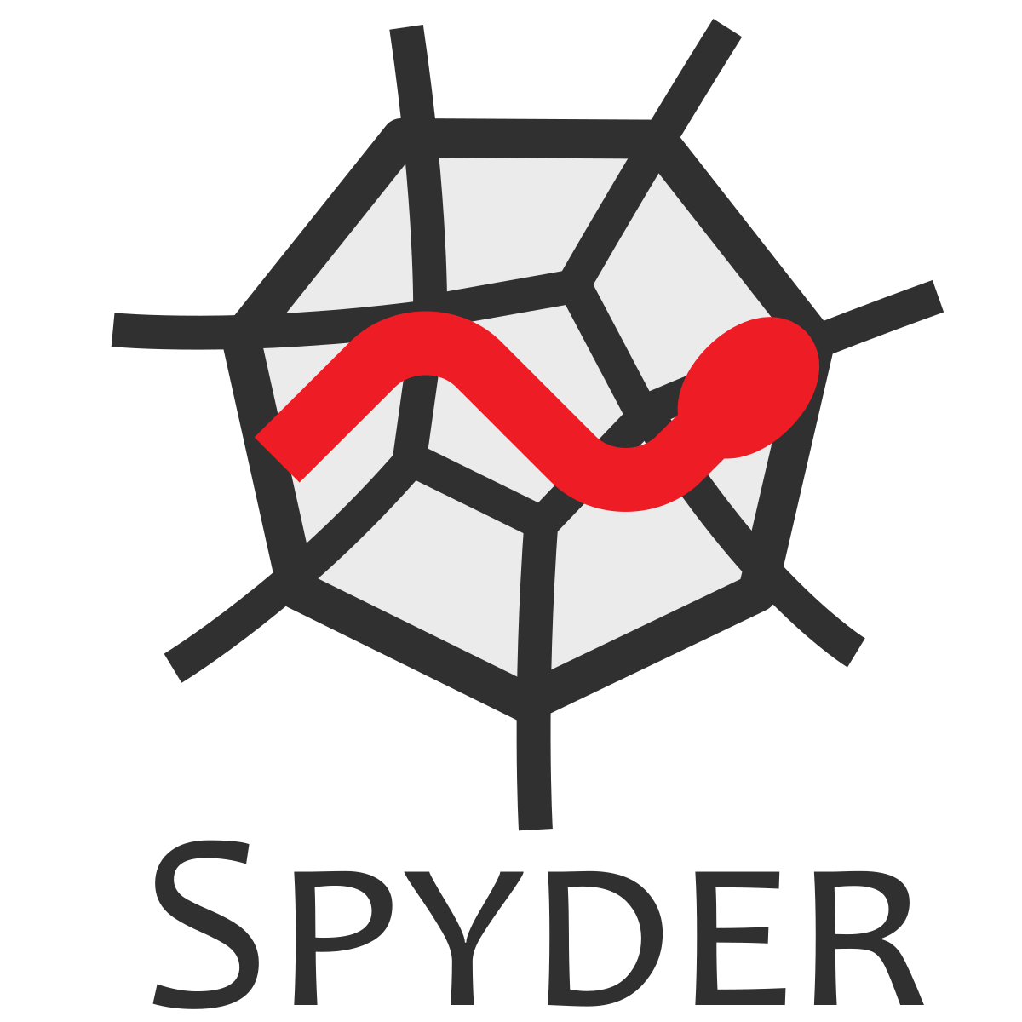
Spyder
Spyder, the Scientific Python Development Environment, is a free integrated development environment (IDE) that is included with Anaconda. Once run, you can attached codes directly to your paper for computational reproducibility of the results.

Slide 21
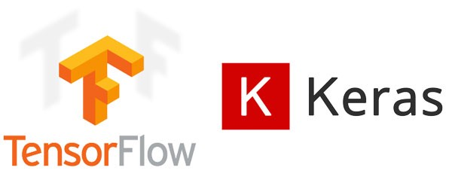
KERAS
Keras is a high-level neural networks API, written in Python and capable of running on top of TensorFlow.It commonly used neural-network building blocks such as layers, objectives, activation functions, optimizers, and a host of tools to make working with image and text data easier

Slide 22
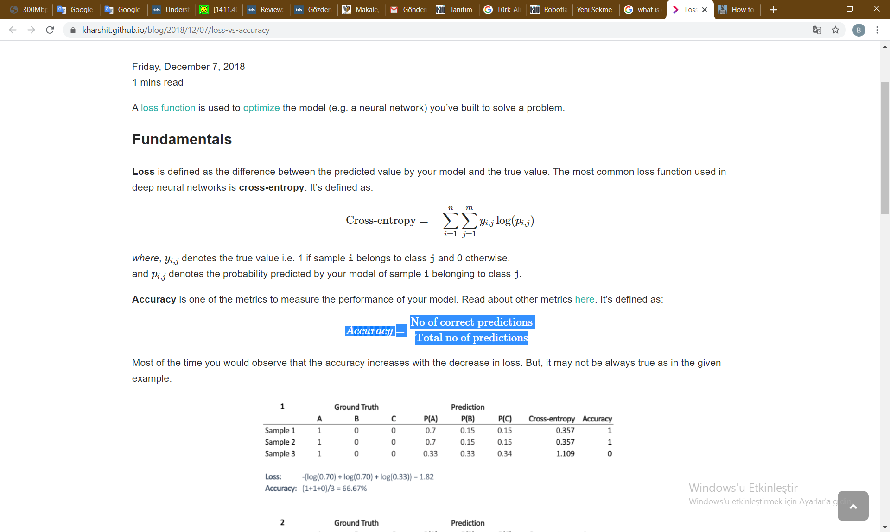
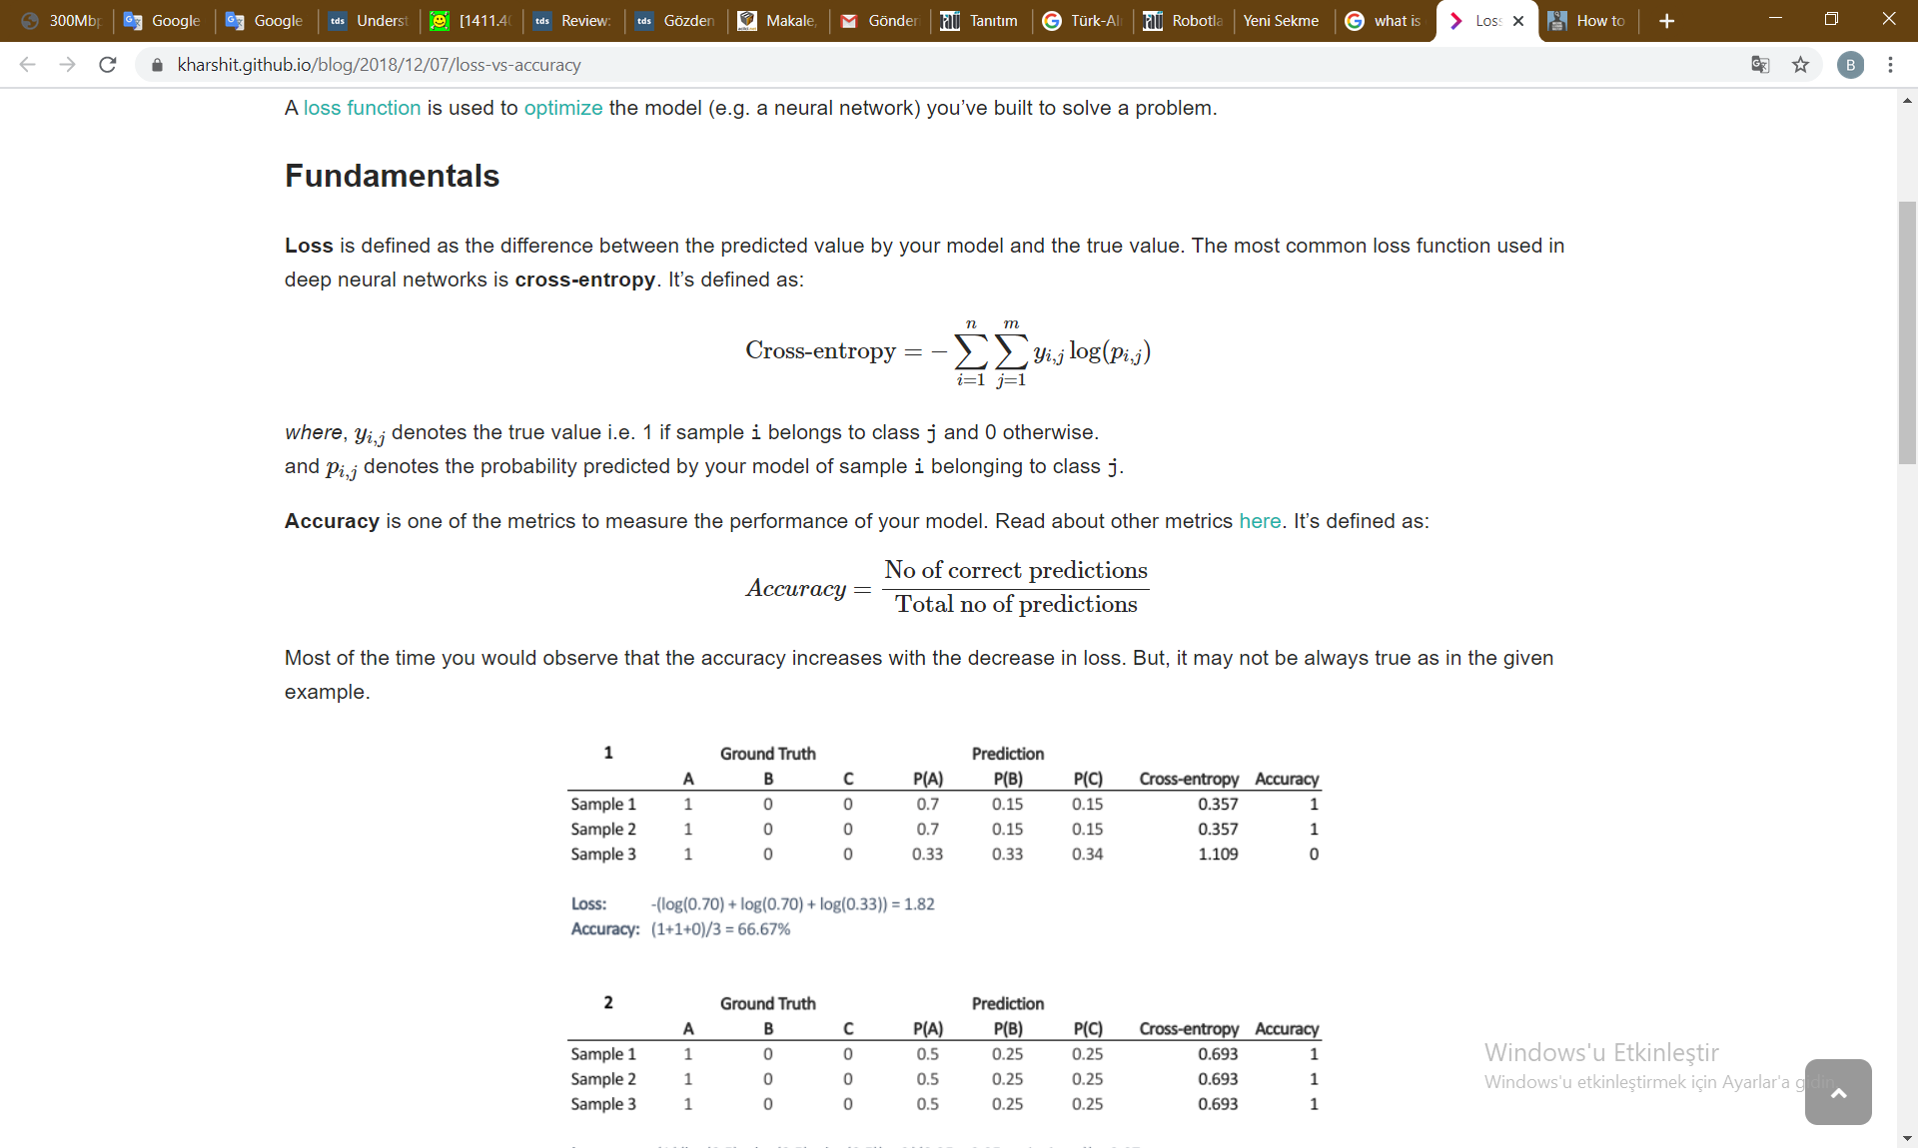
In Keras API
Accuracy Calculation is: Loss Calculation is:
Where, yi,jyi,j denotes the true value .
And pi,jpi,j denotes the probability predicted by our model
Sample i belonging to class j

Slide 23
Programming Steps in Deep Learning

Slide 24
Creating Masks of Knee Femoral Cartilages on MR images
Preprocessing Images to enhance images to read
Create mask of knee cartilages while segmenting by using pyKNEEr library
Preparing Images to Read
Converting 3D Images to 2D Images
Changing all images to numbers arrays
Normalization of arrays .It makes the numbers closer each other.Work is more easier)
Loading Prepared All Datas And Split Them Into Train And Validation Dataset
Builting U-net and ResU-net Architectures and compiling model for Converting arrays to model
Fitting Models(for training) and Plotting Results(After every epochs, accuracy and loss values are calculated to find best model)
Evaluating Model(After fitting process , Best accuracy and loss values obtained.Loading best model and evaluting on validation dataset (If not predict on validation dataset , it is not necessary. Just use loading best model)
Prediction on Model and Displaying Results

Slide 25
RESULTS

Slide 26
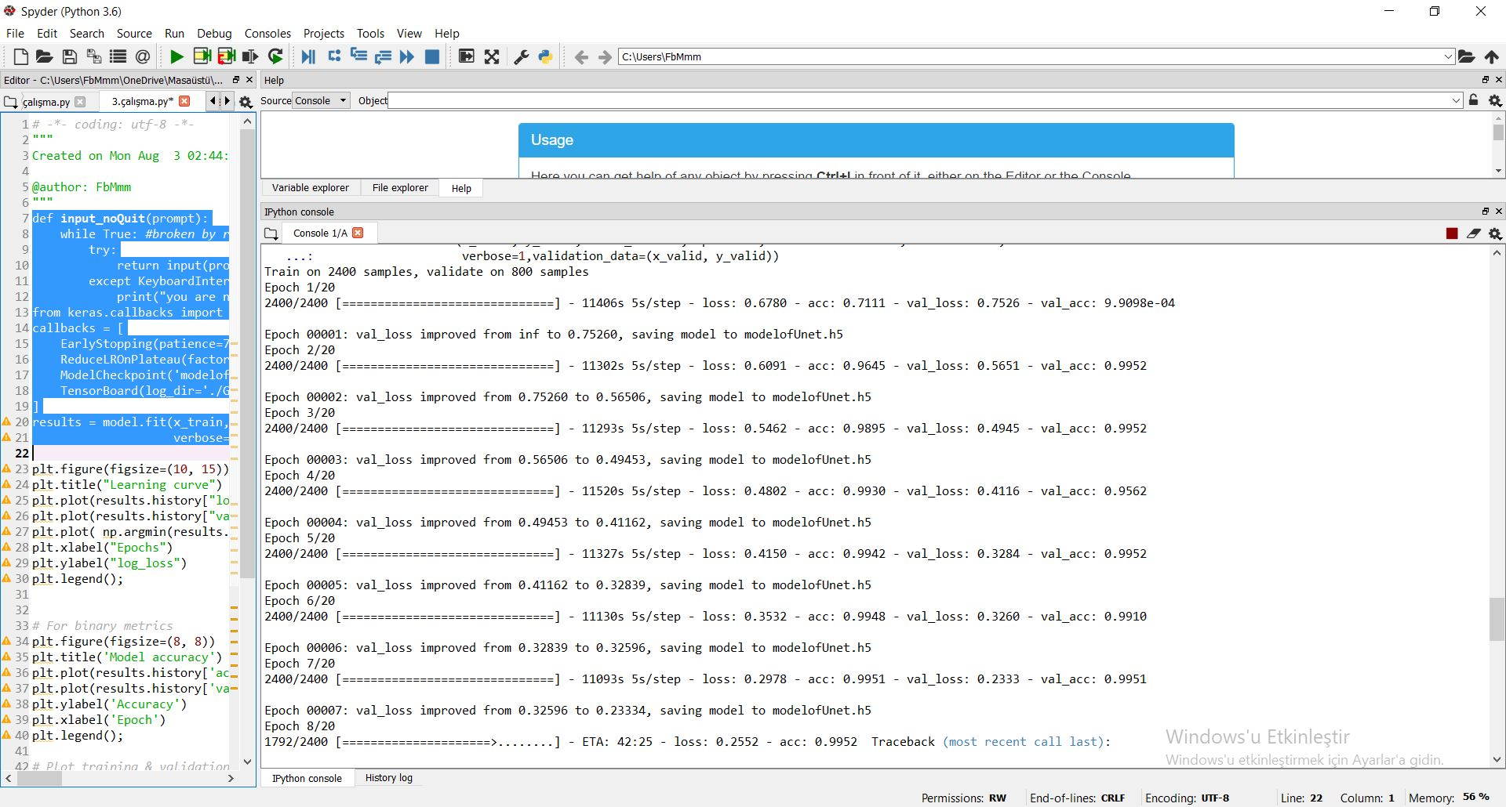

Slide 27
U-NET

Slide 28
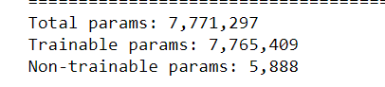
After compiling Model
Used 7.765.409 parameters for training in U-net

Slide 29
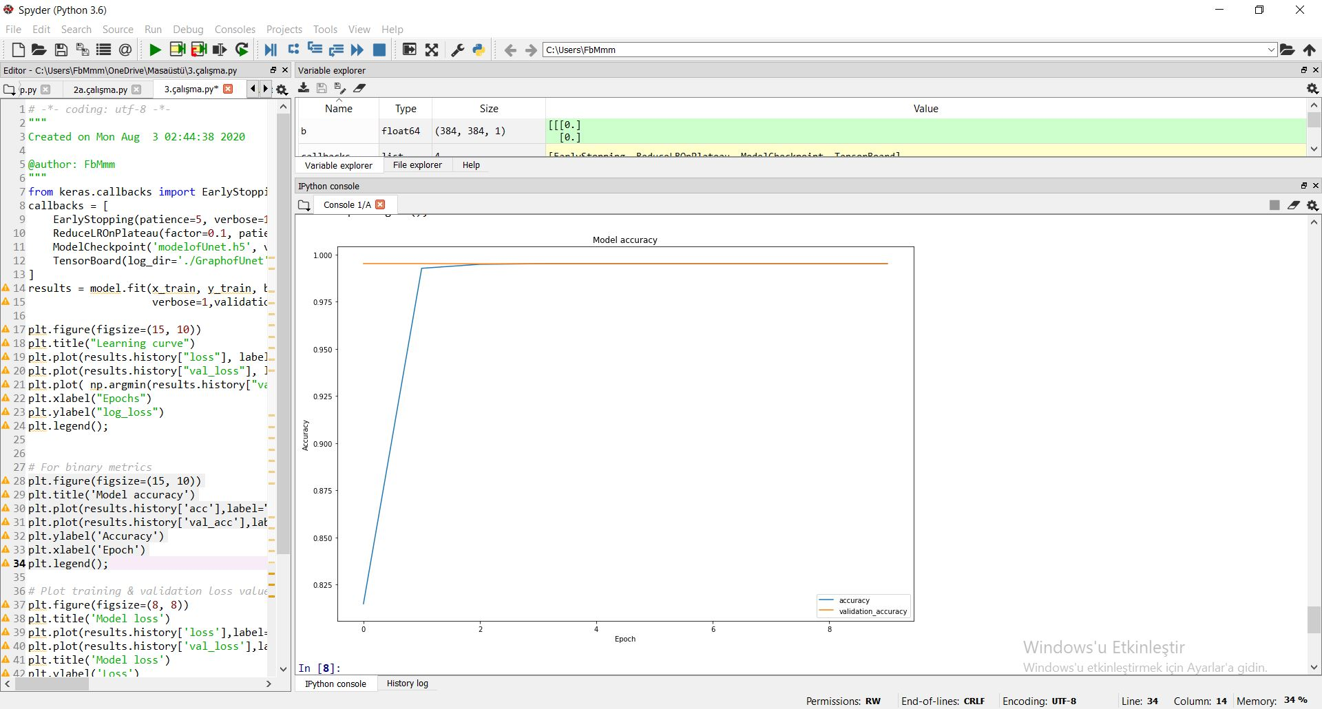
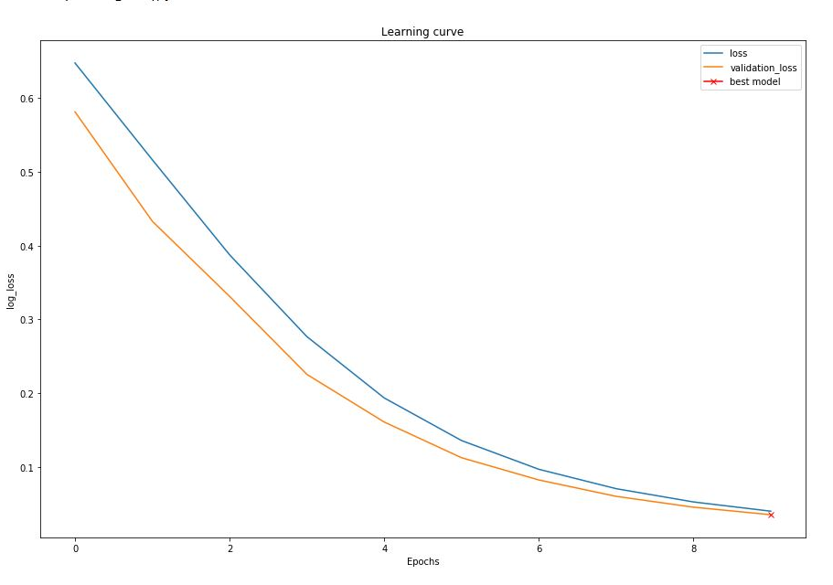
Graphs of Change In Training Time After Fitting Model
After one epoch, loss=0.678 ,acc=0.711 ,val loss=0.75, val acc=9.09.
In best learner epoch, loss=0.40,acc=0.995,val loss=0.35, val acc=0.995.

Slide 30
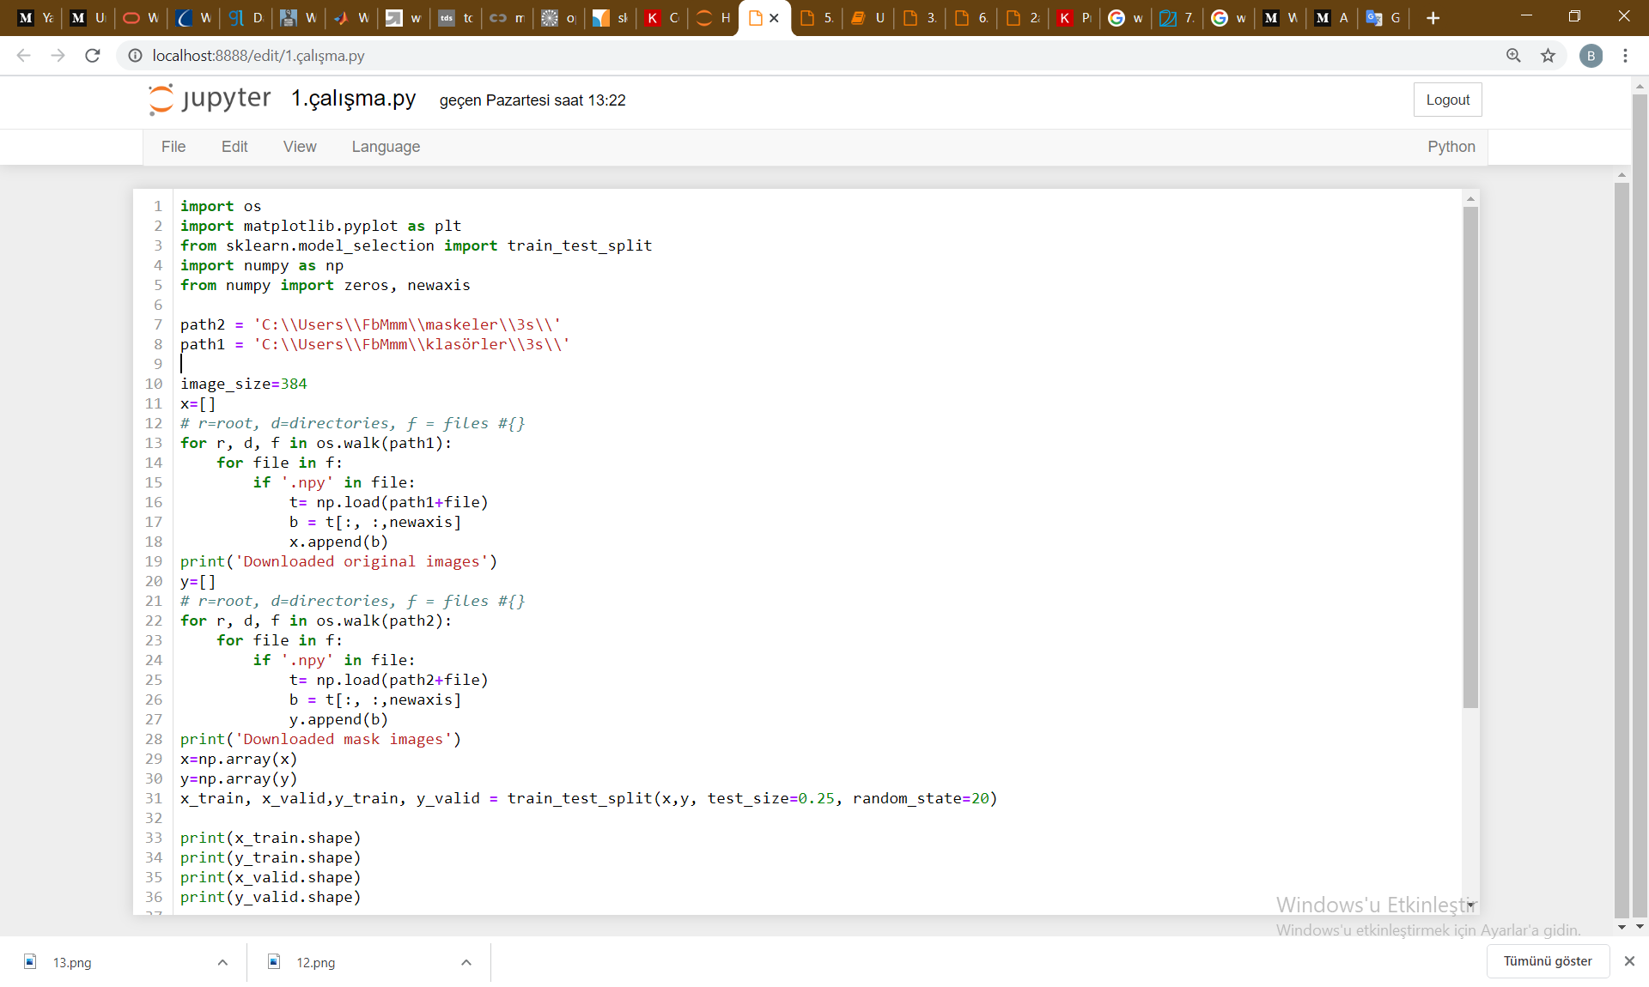

Slide 31
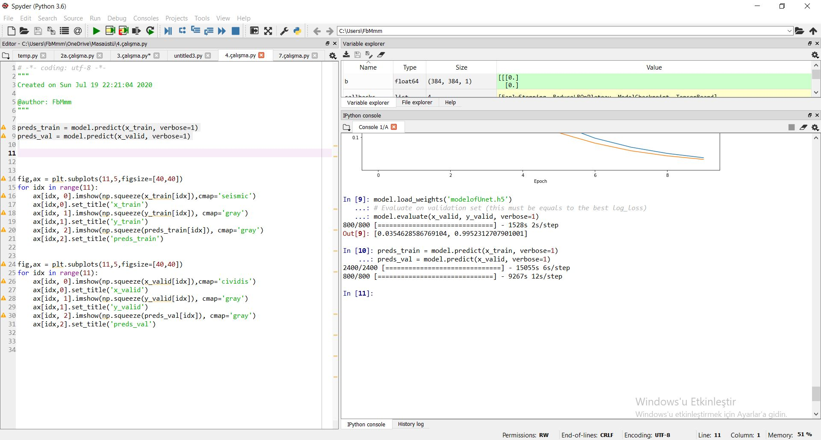
After Evaluating Model
They are that best loss percentage is 3% and accuracy is 99.5% after evaluating

Slide 32
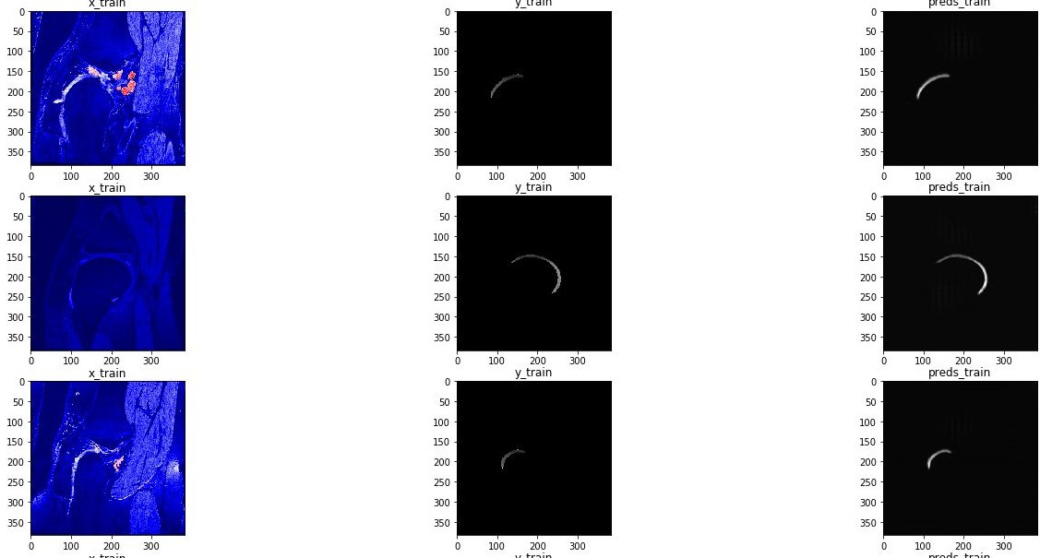
After Prediction on Train Dataset
Pictures of train images(left) its train masks(middle) and predictions(right) mask in U-net model

Slide 33
RESU-NET

Slide 34
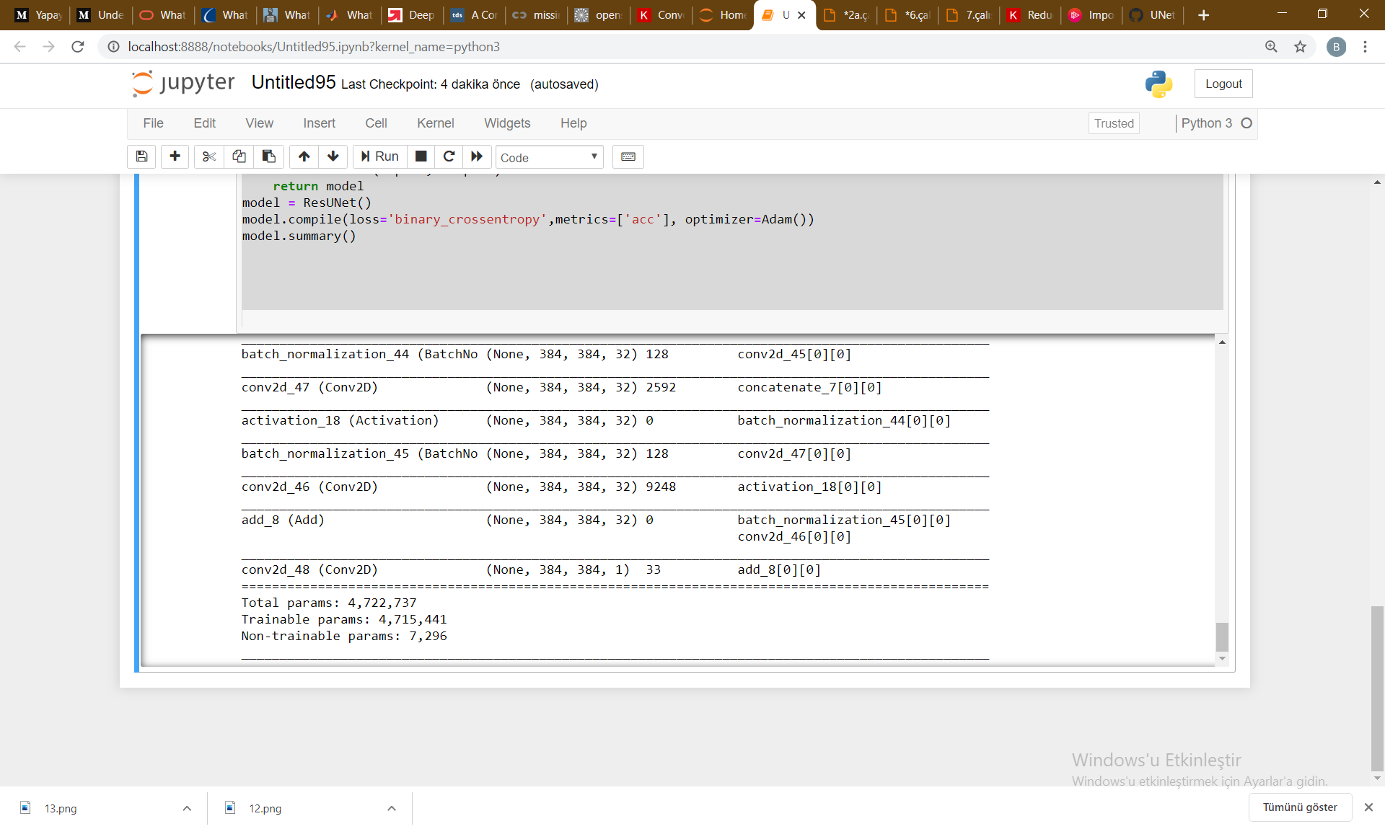
After compiling Model
Used 4.715.441 paramteters in
ResU-net model

Slide 35
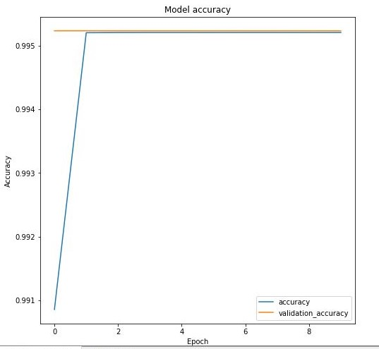
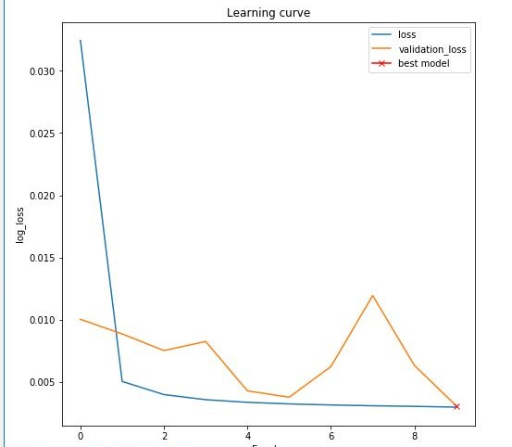
Graphs of Change In Training Time
After one epoch, loss=0.40, ,acc=0. 990 ,val loss=0.1, val acc=0.90
In best learner epoch, loss=0.0032,acc=0.995,,val loss=0.0031, val acc=0.995.

Slide 36
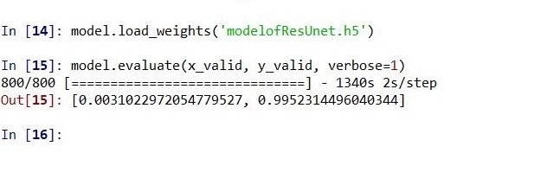
Evaluating Model
They are that best loss percent is 0.3% and accuracy is 99.5% after training

Slide 37
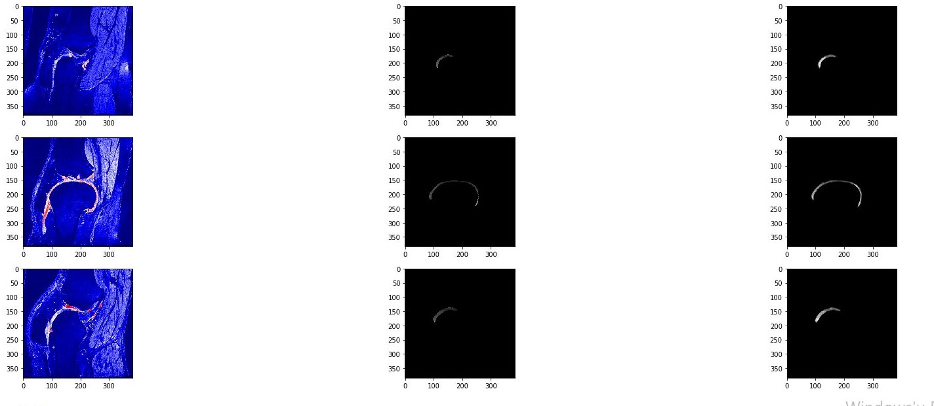
After Prediction on Train Dataset
Pictures of train images(left) its train masks(middle) and predictions(right) mask in ResU-net model

Slide 38
DISCUSSION

Slide 39
When to discuss results , We should taking a basis questions which are :
How are close loss and validation each other?(It shows how much my program learned)
How close are accuracy and validation accuracy each other?
How close are loss and validation to 0?
Is there enhancement after all epochs?(This is expected in this project)

Slide 40
When to compare U-net and Res U-net:
Apparently, the prediction of both of them are very good and they made like same prediction analysis. Loss of less than 50 percent in the literature is considered like it is good.
When to compare all values, Res U-net has the best model because it has lowest loss , validation loss and lowest difference of them.The Winner is Res U-net mathematically.
Best Model In U-net
Diffrence of loss and validation loss is 0.05.
Difference was reduced by 0.03 points after epochs.
Their values are acceptable.
Difference of accuracy and validation accuracy is 0. Their values are so close 100%.
Between of first epoch and best epoch , loss was reduced by 0.27 and validation loss is reduced by 0.4. There is a very good development.
From beginning to finish,There is really enhancement
Best Model In ResU-net
Diffrence of loss and validation loss is 0.0001.
Difference was reduced by 0.2999 points after epochs. Their values are so acceptable.
Difference of accuracy and validation accuracy is 0. Their values are so close 100%.
Between of first epoch and best epoch , loss was reduced by 0.3968 and validation loss is reduced by 0.0969. There is a very good development.
From beginning to finish,There is really enhancement

Slide 41
THE END

